Slide 1
Web /Mobile based tool for mapping of Water supply network
CSE 7101- Capstone Project
Review-2
Batch Number: COM 52
Roll Number | Student Name
20221COM0041 | MOHD. QALANDAR
20221COM0130 | SHERLIEN MOLLY D
20221COM0009 | NAVNEETH PANDEY
Under the Supervision of,
Dr. VIJAY Assistant Professor
School of Computer Science and Engineering
Presidency University
Name of the Program: COM-Computer Engineering
Name of the HoD: Dr. PALLAVI
Name of the Program Project Coordinator: Ms. Benitha Christinal J
Name of the School Project Coordinators: Dr. Sampath A K , Dr. Geetha A

Slide 2
Abstract
This project describes a new, cost-effective web and mobile tool for mapping and managing water supply networks. Developed in response to the Jal Jeevan Mission, the platform fills a critical gap in affordable, integrated digital solutions for water infrastructure. Current proprietary systems, like ArcGIS, are costly and lack essential features like real-time monitoring and grievance redressal.
Our solution integrates three key components into one platform: a geospatial database of water infrastructure, a real-time IoT alert system for network issues, and a user-friendly grievance redressal system. A literature review from 2015-2025 confirms that while these components have been studied separately, their seamless integration into a single, scalable, and affordable tool is a significant innovation. By using open-source technology, this project provides a practical and economically viable solution for proactive water resource management.
GitHub Link : https://github.com/MOQA-01/Capstone-COM_52

Slide 3
Problem Statement Number: PSCS_95
Organization: Ministry of Jal Shakti
Category : Software
Problem Description:
Jal Jeevan Mission was launched with the vision of providing drinking water in adequate quantity of prescribed quality on regular and long-term basis to every rural household. A cost effective technology is required for providing web/ mobile based tool for mapping of water supply network through creating geospatial database of all major structure of Water supply system with provision with grievance redressal and IoT system for alert monitoring.

Slide 4
Objectives : Addressing the Gaps
The project's objectives are clearly defined and structured to address the specific requirements of the problem statement.
The project aims to achieve the following five core objectives:
Develop a geospatial database of all major water supply network structures, including pipelines, pumping stations, and distribution points.
Build a web-based mapping tool for the visualization and management of the water supply network data.
Create a mobile application for field workers to collect and update data on the water supply network in real-time.
Implement a grievance redressal system that allows users to report issues and track the status of their complaints.
Integrate an IoT alert system for monitoring key parameters, such as water pressure and flow rates, and generating real-time alerts for system anomalies.

Slide 5
Objectives : Addressing the Gaps
The synergy between these objectives constitutes the project's primary innovation. While the academic literature confirms the existence and feasibility of each individual component—GIS mapping, IoT monitoring, and citizen engagement applications—it also reveals a significant fragmentation. For instance, studies on mobile applications for utility management highlight the need for on-site data collection , while research on IoT emphasizes real-time data collection for efficient water management.⁵
Similarly, the use of interactive applications for complaint filing is well-documented.⁶ However, a unified, comprehensive platform that seamlessly integrates these three distinct functions within a single, purpose-built, and cost-effective framework is notably absent in the contemporary research landscape. The project's structure, therefore, is not a simple collection of features but a deliberate and strategic combination of validated technologies to create a holistic solution that fills a crucial void in existing practices and tools.

Slide 6
Literature Survey
The project is grounded in an extensive review of the existing technological landscape, particularly focusing on research papers published between 2015 and 2025. This analysis reveals a clear picture of the state-of-the-art in water management technology and highlights the specific gaps that the proposed solution is designed to fill. The survey is broken down into four key thematic areas to provide a comprehensive and nuanced understanding.
Geospatial Information Systems (GIS) for Water Management
The use of GIS for utility management has been a prominent area of research, with tools like Esri's ArcGIS being effective for mapping large-scale networks. The literature emphasizes the importance of a digitalized information model with a comprehensive and unified database for efficient utility management. Studies have also explored the use of remote sensing for obtaining up-to-date data on vegetation and river health, demonstrating the value of geospatial data in environmental management.⁷ However, a recurring theme is the high cost and proprietary nature of many of these advanced GIS solutions, which makes them less practical for a large-scale, low-budget government mission. The project's proposed use of PostgreSQL with the PostGIS extension directly responds to this, providing a powerful, open-source alternative that supports the creation of a digital, geospatial database in a cost-effective manner.

Slide 7
Literature Survey
Internet of Things (IoT) for Water Network Monitoring
The convergence of the Internet of Things (IoT) and artificial intelligence (AI) has revolutionized the field of water quality and flow monitoring.⁴ Research shows a growing adoption of wireless-enabled microcontrollers, such as the ESP32 and Arduino, for real-time tracking of various parameters. These low-cost devices, often used in conjunction with sensors for water flow, temperature, and pressure, enable continuous surveillance of aquatic environments.⁵ The academic community has also developed prototype systems using these microcontrollers and cloud servers to provide real-time data for water consumption and anomaly detection.⁵ A key challenge identified in the systematic reviews, however, is the problem of "sensor fouling" and the "complexity of calibration". These issues can compromise data accuracy and reliability, presenting a hurdle for the practical implementation of IoT-based systems.

Slide 8
Literature Survey
The Role of AI and Data Analytics
The challenges associated with raw sensor data have led to a parallel focus on the integration of AI and machine learning. AI algorithms can intelligently process the vast datasets generated by IoT sensors to provide deeper insights and enhance monitoring accuracy.⁴ This includes performing real-time calibration, correcting errors, detecting anomalies, and denoising data.⁴ The use of AI shifts the paradigm from simple data collection to predictive analysis, enabling the forecasting of pollution events and the optimization of resource management.⁴ By processing and refining the data, AI systems can create dynamic early-warning systems and support proactive environmental management, directly addressing the limitations posed by raw sensor data and moving beyond reactive problem-solving.⁴ The project's approach, therefore, is not simply to collect data but to create a framework that can one day leverage these advanced data processing techniques.

Slide 9
Mobile Applications and Citizen Engagement
The literature confirms the increasing role of mobile applications in utility management. They are recognized as a vital component for on-site monitoring and maintenance, allowing field workers to collect and update data with mobility and efficiency. Beyond internal use, mobile applications are also powerful tools for citizen engagement and communication. Studies on disaster risk communication applications, for example, demonstrate their effectiveness in disseminating real-time information, providing access to early warnings, and offering a platform for filing complaints.⁶ The existence of these tools provides a strong precedent and validation for the project's grievance redressal system, which is a core requirement of the problem statement.

Slide 10
Identified Gaps in Existing Research and Tools
The comprehensive literature survey revealed that while the individual technological components required for this project are well-established, significant gaps exist in their practical and integrated application. The proposed project is a direct response to these identified voids in the current technological landscape.
Gap 1: Fragmentation and Lack of Integration.
While GIS tools, IoT monitoring systems, and citizen grievance applications exist as separate entities, a single, integrated platform that combines all three is not widely available, particularly not in a cost-effective, open-source model. The existing research points to the individual strengths of these technologies but does not provide a blueprint for a cohesive system where a field worker's mobile report of an anomaly, an IoT sensors real-time alert, and a citizen's complaint are all managed through a unified geospatial interface.¹ This fragmentation necessitates the creation of a purpose-built solution.

Slide 11
Identified Gaps in Existing Research and Tools
Gap 2: High Cost and Inaccessibility.
Many advanced GIS solutions are proprietary and prohibitively expensive, rendering them impractical for large-scale public initiatives in low-resource settings. The literature review highlighted that for the broader adoption of IoT technologies in water monitoring, there is a clear need for "affordable hardware" and systems that can be integrated without significant financial barriers. The project's deliberate choice of open-source software and low-cost hardware addresses this fundamental economic barrier.
Gap 3: Proactive vs. Reactive Management.
Traditional water management systems often operate reactively, responding to issues only after they are reported or become critical. While the academic literature on AI and IoT strongly advocates for a shift to proactive, predictive management, the practical implementation of such systems remains limited, especially in a cost-effective and scalable manner.⁴ The project's integrated IoT alert system aims to bridge this gap, allowing for early detection of issues and enabling a more efficient, preventative maintenance model.

Slide 12
Proposed Methodology and Solution
The proposed methodology is centered on the development of a holistic and integrated platform that directly addresses the gaps identified in the literature. The solution leverages a modern, open-source technology stack to ensure it is both cost-effective and scalable for the Jal Jeevan Mission.
The core of the system is the geospatial database, which serves as the single source of truth for all water network infrastructure data. The web and mobile applications provide the user interfaces for data visualization, management, and collection. The IoT system provides the real-time data layer, and the grievance redressal system offers a crucial feedback loop from the public. Each technology choice has been meticulously selected and is justified by the findings of the literature survey.

Slide 13
Technology Stack Justification
Component | Technology | Justification
Database | PostgreSQL + PostGIS | Open-source, scalable, and supports complex geospatial data for unified utility representation.
Web Frontend | React.js / Angular + Mapbox GL JS / Leaflet | Build dynamic, interactive, and cost-effective web apps for geospatial data visualization.
Mobile Frontend | React Native / Flutter | Cross-platform apps from one codebase; supports on-site monitoring and updates.
Backend & APIs | Node.js / Python (Django/Flask) | High-performance server-side frameworks for data processing and APIs.
IoT Protocol | MQTT | Lightweight and reliable for low-bandwidth, real-time IoT data transmission.

Slide 14
System Architecture
The system architecture is designed as a multi-tiered, integrated platform to ensure seamless data flow from the field to the end-user.
The architecture is composed of the following layers:
IoT Layer: This layer consists of IoT sensors for measuring parameters like water pressure and flow rates. The sensors are connected to microcontrollers, such as ESP32 or Arduino, which are known for their cost-effectiveness and wireless capabilities.¹ These devices collect data and transmit it securely to the central server using the MQTT protocol.
Backend Layer: The central processing hub of the system. A server, running on Node.js or Python, receives data from the IoT devices, the mobile application, and the web application. It processes this information and stores it in the PostgreSQL database with its PostGIS extension. The backend also hosts the APIs that the front-end applications use to retrieve and update data.
Geospatial Database: PostgreSQL with PostGIS serves as the core data repository. It stores not only the network infrastructure data (e.g., pipeline geometries, pumping station locations) but also the dynamic data from the IoT sensors and the complaint information from the grievance redressal system. This centralization of data is key to providing a unified information model.
Frontend Layer: This layer is where the web and mobile applications reside. The web application, built with React or Angular and a mapping library, provides a comprehensive dashboard for administrators and users to visualize the network, monitor data, and manage complaints. The mobile application, built with React Native or Flutter, allows field workers to collect data on-site and provides an interface for citizens to report grievances.
Simulation Component: For the purpose of this project review and demonstration, the IoT sensor data (e.g., flow and pressure) will be generated and transmitted using software-based simulations. This approach ensures that the entire system's functionality, from data ingestion to real-time visualization and alerting, can be demonstrated effectively without the need for a full-scale hardware deployment, which is a common and practical approach in final-year projects with a focus on software development.

Slide 15
Modules and Functionalities
The tool's functionality is organized into three primary modules, each designed to address a specific aspect of the problem statement.
Mapping Module: This is the core visualization component. It provides an interactive map interface where users can view the comprehensive geospatial database of the water supply network. The map will display all major structures, including pipelines, pumping stations, distribution points, and storage facilities. This module serves as a powerful asset for planning, management, and situational awareness.
IoT Monitoring Module: This module provides a real-time view of the network's health. It displays key operational parameters like water pressure and flow rate, as captured by the IoT sensors. The system is designed to trigger automated alerts and notifications when these parameters deviate from predefined thresholds, indicating a potential anomaly or system failure. This functionality is crucial for enabling a proactive maintenance model, as opposed to a reactive one.
Grievance Redressal Module: This module provides a transparent and efficient channel for public engagement. It allows users to submit complaints regarding water-related issues directly through the mobile or web application. Each complaint is logged with its location and details, and a unique tracking number is provided. The system enables administrators to manage, track, and resolve these issues, ensuring a proper feedback loop and promoting accountability. The inclusion of this module recognizes the importance of citizen participation in effective infrastructure management.

Slide 16
Feasibility Study and Novel Contribution
The project's feasibility is demonstrated from both a technological and a resource perspective, and its novelty is clearly articulated in its integrated approach
.
Technological Feasibility: All technologies selected for the project, from the database (PostgreSQL) to the front-end frameworks (React, Flutter) and IoT protocols (MQTT), are mature, widely-supported, and open-source. Their individual capabilities have been validated in numerous academic and commercial applications. The project's innovation does not rest on the creation of new technology but on the strategic integration of existing, robust tools to solve a specific and complex problem.
Cost and Resource Feasibility: By exclusively using open-source technologies, the project's development and deployment costs are significantly lower compared to solutions that rely on proprietary software licenses. This aligns with the problem statement's requirement for a "cost-effective technology" and directly addresses the high financial barriers identified in the literature for large-scale, low-resource settings. The scalable nature of the chosen technology stack ensures that the system can be expanded to cover larger geographic areas and a growing number of users without a corresponding exponential increase in cost.

Slide 17
Feasibility Study and Novel Contribution
Novel Contributions: The project's primary contribution is its integrated, holistic solution. It moves beyond the fragmented landscape of existing tools by creating a single, cohesive platform that combines geospatial mapping, real-time IoT monitoring, and a grievance redressal system. The tool is purpose-built to meet the unique needs of the Jal Jeevan Mission, making it more relevant and effective than generic GIS solutions. This integrated approach also facilitates a shift from reactive to proactive network management. The IoT-based alert system provides real-time data that enables early detection of potential problems, allowing for preventative action rather than simply reacting to failures or complaints. This predictive model for maintenance and management represents a significant advancement in the field of public utility administration.

Slide 18
Software Requirements
Operating Systems: Windows, macOS, or Linux are all suitable for the development environment.
Development Tools: VS Code for code editing, Git for version control, and Node.js and Python for backend development.
Mapping Libraries: Leaflet or Mapbox GL JS will be used to handle all mapping functionalities and geospatial data visualization.
Database: PostgreSQL with the PostGIS extension is a mandatory requirement for storing and managing all geospatial data and related information.
Cloud Platform: A cloud service such as Amazon Web Services (AWS), Google Cloud Platform, or Microsoft Azure will be required for deploying the backend server and hosting the database.

Slide 19
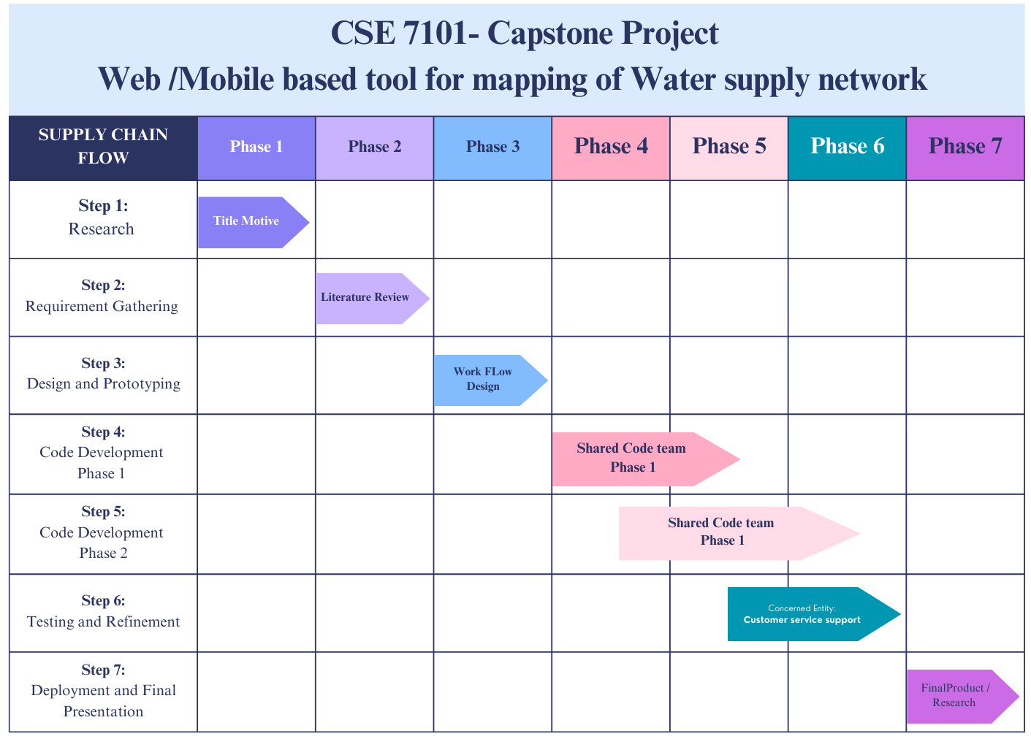
Project Timeline : (Gantt Chart)

Slide 20
References (IEEE Paper format)
[1] Dai, Y., Huang, Z., Khan, N., & Labbo, M. S. (2025). “Smart Water Management: Governance Innovation, Technological Integration, and Policy Pathways Toward Economic and Ecological Sustainability,” Water, vol. 17, no. 13, p. 1932. ¹ Available: https://www.mdpi.com/2073-4441/17/13/1932.
[2] Dongare, P., Sharma, K. V., Kumar, V., & Mathew, A. (2024). “Water distribution system modelling of GIS-remote sensing and EPANET for the integrated efficient design,” Journal of Hydroinformatics, vol. 26, no. 3, pp. 567-588. ³ Available:Water distribution system modelling of GIS-remote sensing and EPANET for the integrated efficient design | Journal of Hydroinformatics | IWA Publishing.
[3] Mirshafiei, P., Sadeghi-Niaraki, A., Shakeri, M., & Choi, S. M. (2019). “Geospatial Information System-Based Modeling Approach for Leakage Management in Urban Water Distribution Networks,” Water, vol. 11, no. 8, p. 1736. ⁵ Available: Geospatial Information System-Based Modeling Approach for Leakage Management in Urban Water Distribution Networks.
[4] Kadhim, N. R., Abdulrazzaq, K. A., & Hashim, A. (2021). “The management of water distribution network using GIS application case study: AL-Karada area,” Journal of Physics: Conference Series, vol. 1895, no. 1, p. 012038. ⁷ Available:The management of water distribution network using GIS application case study: AL-Karada area.
[5] Shah, P. P., Patil, A. A., & Ingleshwar, S. S. (2017). “IoT based smart water tank with Android application,” in 2017 International Conference on I-SMAC (IoT in Social, Mobile, Analytics and Cloud) (I-SMAC), pp. 600-603. ⁸ Available:(PDF) Smart Water Management System.

Slide 21
References (IEEE Paper format)
[6] García, L., Parra, L., Jimenez, J. M., Lloret, J., & Lorenz, P. (2020). “IoT-based smart irrigation systems: an overview on the recent trends on sensors and IoT systems for irrigation in precision agriculture,” Sensors (Switzerland), vol. 20, no. 4, p. 1042. ⁸ Available:(PDF) Smart Water Management System.
[7] Robles, T., Alcarria, R., Moran, A., & Lopez, M. (2015). “An Internet of Things-Based Model for Smart Water Management,” Journal of Wireless Mobile Networks Ubiquitous Comput, vol. 5, no. 3, pp. 32-41. ² Available:Smart Water Management: Governance Innovation, Technological Integration, and Policy Pathways Toward Economic and Ecological Sustainability | Semantic Scholar.
[8] Femi, J. G. (2022). “Smart Water Management System,” International Journal of Smart Sensor and Adhoc Network, vol. 3, no. 3, p. 1213. ⁸ Available:(PDF) Smart Water Management System.
[9] Sathiyaseelan, M., et al. (2023). “Smart Mobile Application for Water Supply Management in Urban Cities,” IJMRT, vol. 5, no. 6. ⁹ Available:Smart System Application for Water Supply Management using Web Technology.
[10] Mukhtarov, F., Dieperink, C., & Driessen, P. (2018). “The influence of information and communication technologies on public participation in urban water governance: A review of place-based research,” Environmental Science & Policy, vol. 84, pp. 1-10. ² Available:Smart Water Management: Governance Innovation, Technological Integration, and Policy Pathways Toward Economic and Ecological Sustainability | Semantic Scholar.

Slide 22


